Slide 1

Recommendation System: Gaming
Prepared By:
Rajat Gupta
Prasang Prajapati
Subject:
Data Mining
Guided By:
Prof. Feng Chen

Slide 2
Project Description
A Recommendation System tell its user what future decisions will be beneficial for the user.
This system predicts the top 10 popular games using Tweets collector on Twitter.
Furthermore, Based on the different user data which is stored in the system, when a new user selects different games that he has played. On analyzing the data provided by the user, our system will recommend a new game which the user should play by analyzing the available data in the system.

Slide 3
Motivation
As we all are Gamers and play games everyday which enforced us to build this system.
There are lots of games and usually people are confused that which game they should play next. Whether people will have a satisfaction after starting the game as to their taste, this is a demanding question in the real world for us.
Thus, we have built a system which recommends a user to play this game by entering the games a user likes to play generally.

Slide 4
Methods & Applications

Slide 5
1. Tweet Collection
Using Twitter API we have collected tweets. Mainly in this tweet collection method, we have implemented a code in python which automatically takes new tweets from twitter at every one hour by using App Scheduler.
Total | Unique | Training | Testing
11033 | 4869 | 1151 | 3718
: Classification of Tweets
Also we have implemented a code which automatically removes the same tweets which is already present in previously collected tweets.

Slide 6
2. Collected Tweet Analysis
After collecting total 11033 tweets we have implemented the code where we have removed the same tweets from the total tweet and as mentioned in the table, after implementing the above mentioned code we get 4869 tweets that are unique.
Total | Unique | Training | Positive | Negative
11033 | 4869 | 1151 | 289 | 863
After getting unique tweets we manually analyzed the tweets and then we differentiated the Positive and Negative Tweets to generate Training Dataset.
As we can see in the above table, we have collected a total of 11033 tweets, from these 4869 were unique. In our training dataset, we have a total of different positive and negative tweets which are 289 and 863 respectively.
After creating the training dataset, we applied SVM to find positive and negative tweets on available unique tweets.
The Accuracy of SVM Model was in Low 80’s.

Slide 7
3. Application of Model on Analyzed data
After classifying tweets, we generated the top 10 most frequent words from our Twitter data.
Mainly we found words that were a single word from the name of entire game, where as we need to find a full game name i.e.: Call of Duty, Ghost Recon, NBA 2k17 etc.
Therefore, to overcome this problem, we have approached new method which is explained in later slides.

Slide 8
4. Association Rule
We moved further with the new approach in which we have made a Word Cloud of the collected Tweets. After analyzing the word cloud, we found top 10 most played games in the Word Cloud and then from which we have selected Top 5 popular games for our next recommendation by cross verifying on Steam Community.
In addition to that, we created a small prototype using Association Rule Mining. We have manually entered the game data that includes top 5 most popular game played by some users. With help of this data, we have tried to recommended a game for new user as to which game the user should play next.

Slide 9
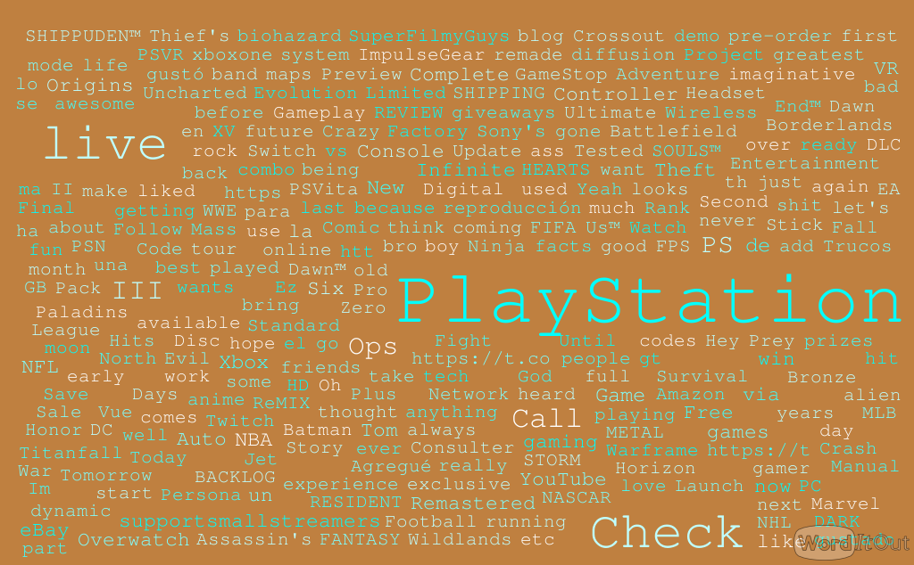
Word Cloud of Collected Tweets

Slide 10
Sneak peek of our System

Slide 11
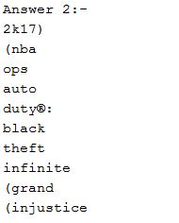
As discussed earlier, firstly we have analyzed the tweets and from the tweets we have gathered top 10 most frequent words. Which is shown below in the output screen:

Slide 12
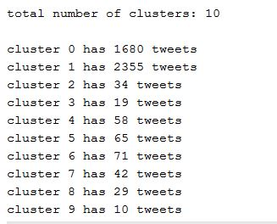
For the next step, in our system, for the word cloud we have made clusters for the tweets which are shown below in the output screen:

Slide 13
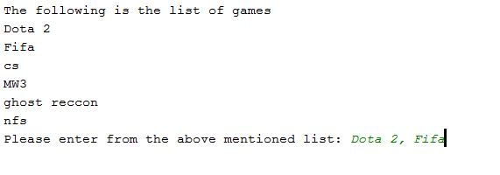
A system which recommends a user to play which game after entering the played games given in the Input screen:
Here, User has entered Dota 2 and FIFA as input, and now user will be recommended a game which the user should play.

Slide 14
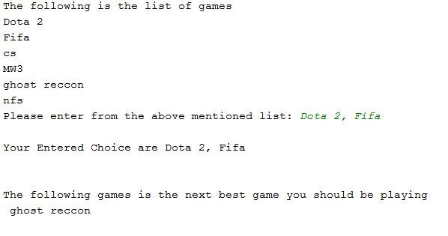
After entering the input user gets output as shown below:

Slide 15

Questions ?

Slide 16


